Slide 1
CENTRAL MASS. MOSQUITO CONTROL
www.cmmcp.org
MOSQUITO AND TICKS IN CENTRAL MASSACHUSETTS
TIMOTHY D. DESCHAMPS
Executive Director
deschamps@cmmcp.org
WESTFORD SPORTSMAN CLUB
MARCH 6, 2023

Slide 2
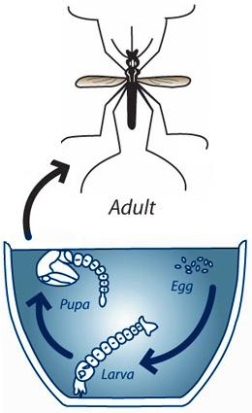
Mosquito biology:
Eggs laid on or near water
Eggs can remain dormant for years
Larvae & pupae develop in still water
Many adult species stay close to
larval habitat
Female mosquitoes need blood to
develop eggs

Slide 4
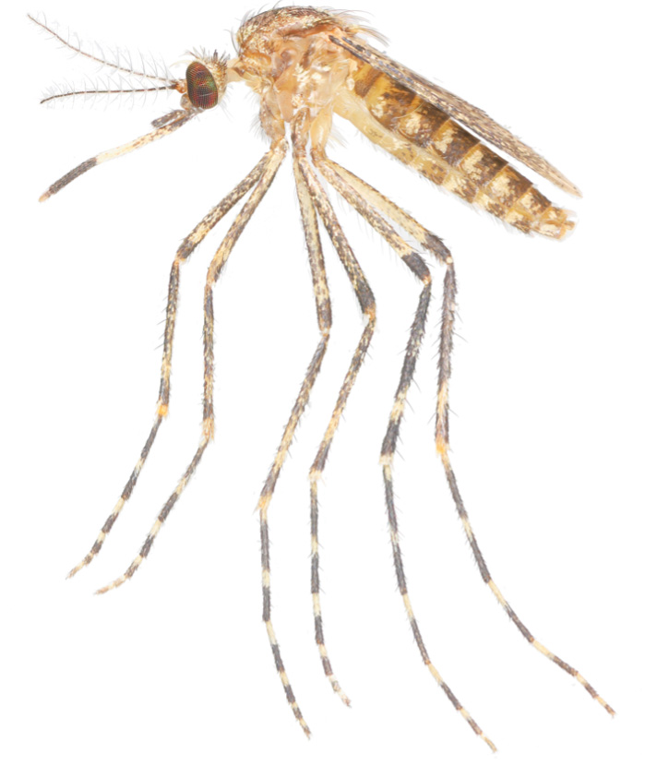
CENTRAL MASS. MOSQUITO CONTROL
www.cmmcp.org
Diseases Carried by Mosquitoes in NE
West Nile Virus
Eastern Equine Encephalitis
Jamestown Canyon Virus
Zika virus
Chikungunya virus
Cattail mosquito
Coquillettidia perturbans

Slide 5
CENTRAL MASS. MOSQUITO CONTROL
www.cmmcp.org
PERSONAL PROTECTION MEASURES
MOSQUITOES

Slide 6
CENTRAL MASS. MOSQUITO CONTROL
www.cmmcp.org
Exclusion:
Repair holes in screens
Reduce outdoor lighting
Use fans when possible
Treat area with insecticide*
Allow sunlight and wind in area
Avoid mosquito activity times (dawn & dusk)
Remove larval habitats
Treat man-made habitats w/bacteria
Cover exposed skin when outdoors
*READ THE LABEL

Slide 7
CENTRAL MASS. MOSQUITO CONTROL
www.cmmcp.org
PERSONAL PROTECTION MEASURES
TICKS

Slide 8
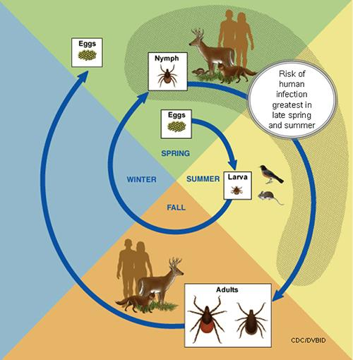
CENTRAL MASS. MOSQUITO CONTROL
www.cmmcp.org
Tick biology:
Larvae emerge from eggs &
attach to rodents
Larvae become nymphs
Nymphs become adults
Each stage needs blood
Highest risk in late spring &
summer

Slide 9
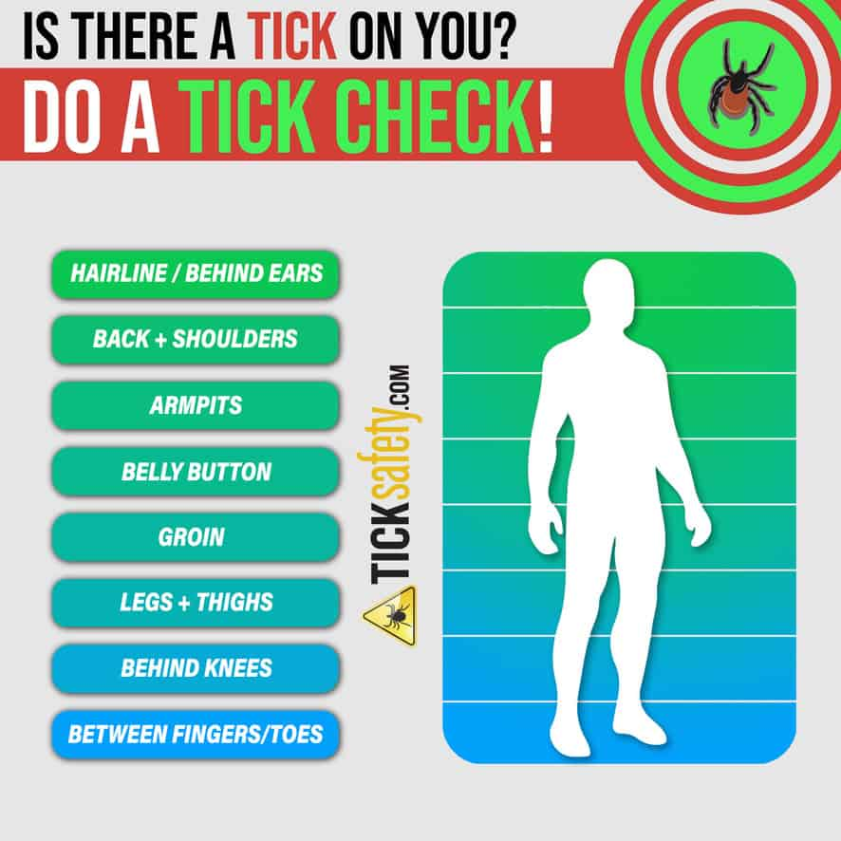
Exclusion:
Remove leaf litter
Cut back tall grass & shrubs
Allow sunlight and wind
Discourage deer activity
Treat area with insecticide*
Treated clothing
Tuck pants into socks or use
gaiters
Tick checks
*READ THE LABEL

Slide 10
CENTRAL MASS. MOSQUITO CONTROL
www.cmmcp.org
Tick & Mosquito Repellents
DEET
Permethrin*
Picaridin
Oil of Lemon Eucalyptus (PMD)
*clothing only

Slide 11
CENTRAL MASS. MOSQUITO CONTROL
www.cmmcp.org
DEET*
The “Gold Standard” since 1946 (military use – 1957 civilian use)
READ THE LABEL – under 30% recommended for children >2 months
Not recommended for infants
*N,N-Diethyl-m-toluamide

Slide 12
CENTRAL MASS. MOSQUITO CONTROL
www.cmmcp.org
Permethrin
Contact insecticide
Intended for use on clothing, bed nets, shoes, camping gear – NOT ON SKIN
Follow label instructions
Very effective against mosquitoes, ticks & other biting insects
READ THE LABEL

Slide 13
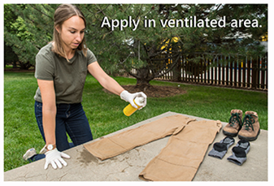
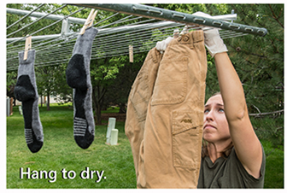
CENTRAL MASS. MOSQUITO CONTROL
www.cmmcp.org

Slide 14
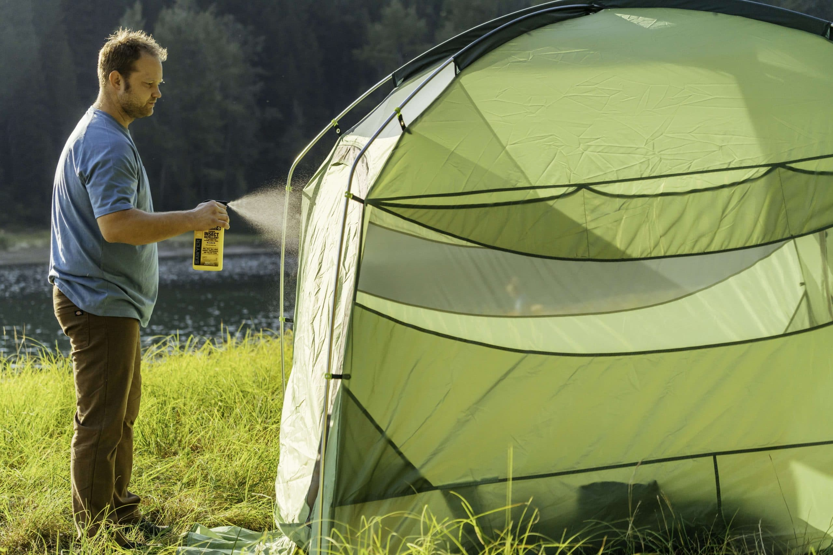

Slide 15
CENTRAL MASS. MOSQUITO CONTROL
www.cmmcp.org
Picaridin & PMD
Shorter effectiveness (comparable to low concentrations of DEET)
Newer products, less data available
Don’t use PMD (oil of lemon eucalyptus) on children under 3 years of age
READ THE LABEL

Slide 16
CENTRAL MASS. MOSQUITO CONTROL
www.cmmcp.org
Natural Repellents
Limited data available of effectiveness and toxicity
Look for products with an EPA registration number
Just because it’s “natural” doesn’t mean it works or is safer than alternatives
READ THE LABEL

Slide 17
CENTRAL MASS. MOSQUITO CONTROL
www.cmmcp.org
Application of Repellents
Don’t use repellents under clothing
Don’t use on cuts or irritated skin
Don’t use repellents near the mouth or eyes and use them sparingly around the ears. When using spray products, spray the product onto your hands first, and then apply it to your face.
READ THE LABEL

Slide 18
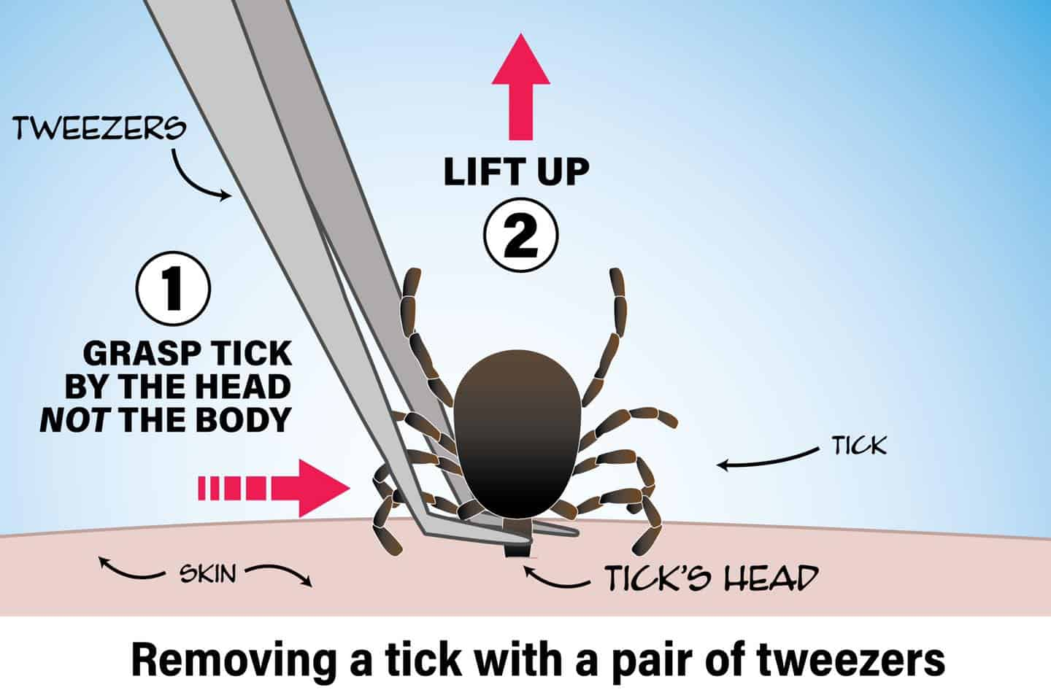
CENTRAL MASS. MOSQUITO CONTROL
www.cmmcp.org
Tick Removal
Use fine tipped tweezers
Grasp head NOT body
Lift up
Clean area with soap &
water
Put tick in bag and date
in case testing is needed

Slide 19
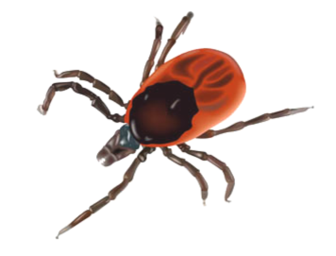
CENTRAL MASS. MOSQUITO CONTROL
www.cmmcp.org
Diseases Carried by Ticks in NE
Lyme disease
Babesiosis
Anaplasmosis
Ehrlichiosis
Tickborne Relapsing Fever (TBRF)
Powassan virus
Tularemia
Rock Mountain Spotted Fever
Ehrlichiosis
Southern Tick Associated Rash Illness (STARI)
Red meat allergy
Black-legged tick
aka Deer tick
Ixodes scapularis

Slide 20
CENTRAL MASS. MOSQUITO CONTROL
www.cmmcp.org
CONTACT INFORMATION
Central Mass Mosquito Control Project
111 Otis St. Northborough, MA 01532
(508) 393-3055
www.cmmcp.org
----------------------------------------------------
Timothy D. Deschamps
Executive Director
deschamps@cmmcp.org

